Slide 1
Seis-Zone Review (Overview)
William Leakey
Version 1.0

Slide 2
Seismic Zone is it Special?
Can Katalyst execute a sale of all lines on the map
Does Katalyst have experts in ownership that can resolve issues quickly
Do you have data and areas of data coverage that is exclusive and only on your site
Do you efficiently track the sales and QI process
Can you efficiently convert a QI to a sale and have an invoice for the broker ready in 4 hours
Do you have a delivery expectation for the data
Do you have service level expectations
4 hours for data resident in Katalyst
3 days for external data sets within your control
Do you have the ability to manage entitlement and sales history for your clients
Is the process predictable repeatable, known, and documented?
Do you manage the entire process, is it within your control?
Why is your service premium, unique, why would I use it?

Slide 3
Business Process Objectives
Map
Needs to be more intuitive
Objective of the map is to get QI’s and present data
Map must be easily filtered
QI Sale Process
Simple, straight forward, interactive with sales desk
Broker or Marketer interface
Informative, Predictable, Process, facilitate partnered data
QI Process
Repeatable, Printable, Professional, Managed
Prompt, efficient, up to industry standards

Slide 4
Setup Considerations System Requirements, Business Requirements
Seismic Zone Contributor
Survey, Line Parameters, QI material, Ownership
Fees structure, Inventory Access, Business Contact
Katalyst Client Contributor
Survey, Line Parameters, QI material, Inventory, Ownership
Fees structure, Inventory Access, Business Contact
Katalyst Owned Data
Survey, Line Parameters, QI material, Inventory, Ownership
Fees structure, Inventory Access, Business Contact
Key Requirements
Client Representation
Data Representation
Negotiated Sales Framework
Data Exclusivity

Slide 5
User Roles
Guest
Browsing Only. No special Privileges, Once registered assumes role of a client
Broker
Sales person who acts as a broker, works with client, facilitates sale
Order QI’s materials, Partnership approvals, Price Negotiation, Fee Structure
Client
Proprietary data, Entitlements, Own Land, Land Sales, Wells, etc.
Clients can monitor the sales activity of own data, Land, Wells, etc.
Client Enquires – Katalyst Broker/Data Manager
Marketer(Katalyst)
Person who works for Katalyst selling data. Same role as broker, except does not get the full brokerage commission. The client may not be a client of the system, and the data that is being sold many not be on the Katalyst system.

Slide 6
Login Requirements (Roles Views)
Login needs to support
Admin, Company, Groups, Users, Roles
Reports, Applications Security, Map Layers, Custom Reports
Preferences, Sales Activity, QI Activity
Data Layers
Land, Seismic, Wells, Entitlements etc.
Ownership- Preapproved, Operated
Map Preferences
Client Privileges, Map Center, Editing Privileges, Viewing Privileges, Book Marks, Sales Enquires

Slide 7
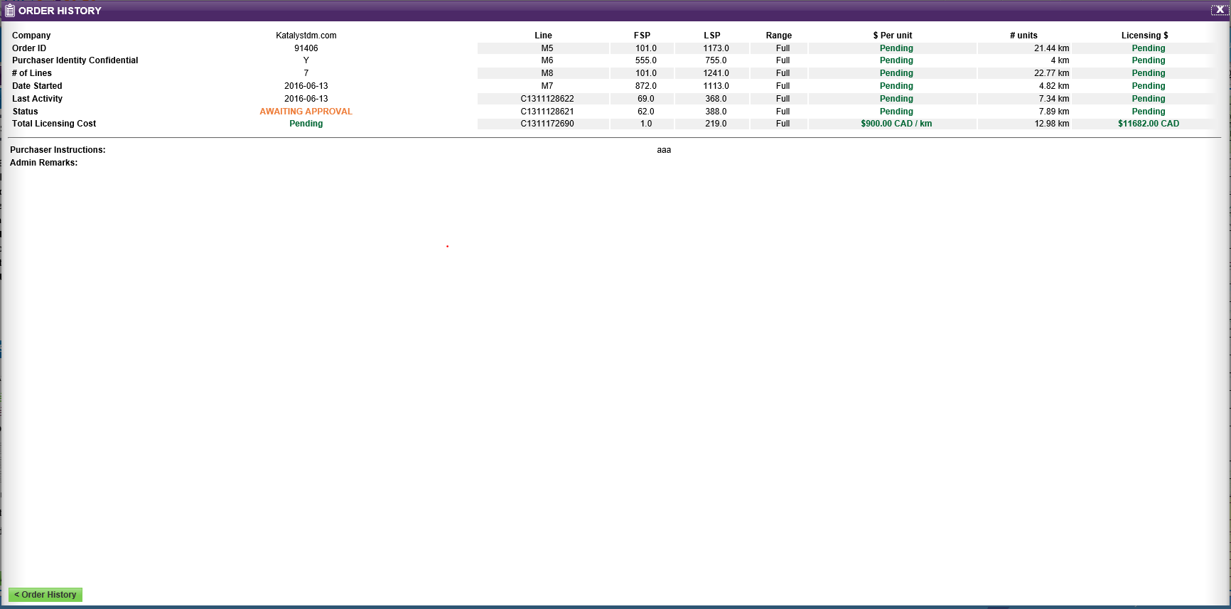
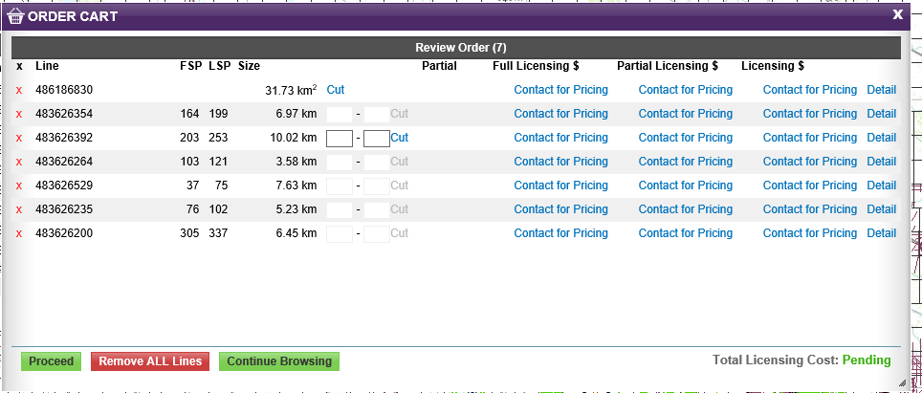
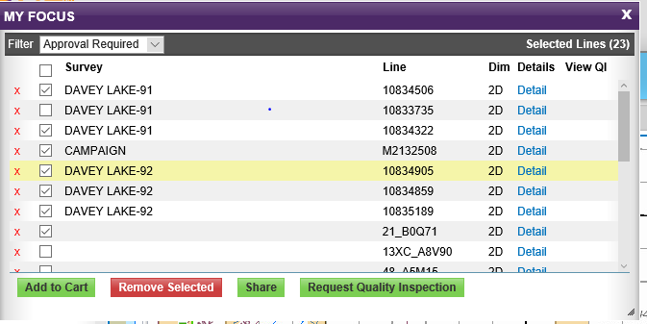
This Screens Need Rework
Not Consistent Format
Don’t Flow
Don’t contain correct information
Status of QI
No Reference Number
No sales status
Dates, Transaction, Invoice

Slide 8
Page Changes (Screen)
Add Vintage, Fold Columns, Source
Change map selection so more then one line on the map at a time can be selected, make it more active with MyFocus
Map Legend – My Focus
Add energy source into the column of My Focus and take it off map
Add Fold in the column of My Focus and take it off the map
Add Energy Source to My Focus and take it off the map
Add Land Marine, column
Remove Selected
I would Remove Unselected lines and use the window as a working buffer.

Slide 9
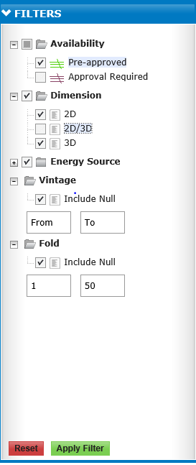
Legend Filters
Get rid of APPLY FILTER, and have legend interact with map it is to primitive functionality.
Remove Energy Source, the list is too long and meaning less to a lot of people
Get rid of the FOLD and put it into the MY FOCUS
Get rid of the 2d/3d doesn’t make sense
The map should interact directly with the legend and there should be no apply button.
A LAND Filter should be added
Prairie Sky, Heritage Oil, Free Hold Royalties
Land Sales
Partial Disposed Crown
Open Crown
Can the LEGEND be 3 Levels deep.
Some land companies may be want to include their seismic.

Slide 10
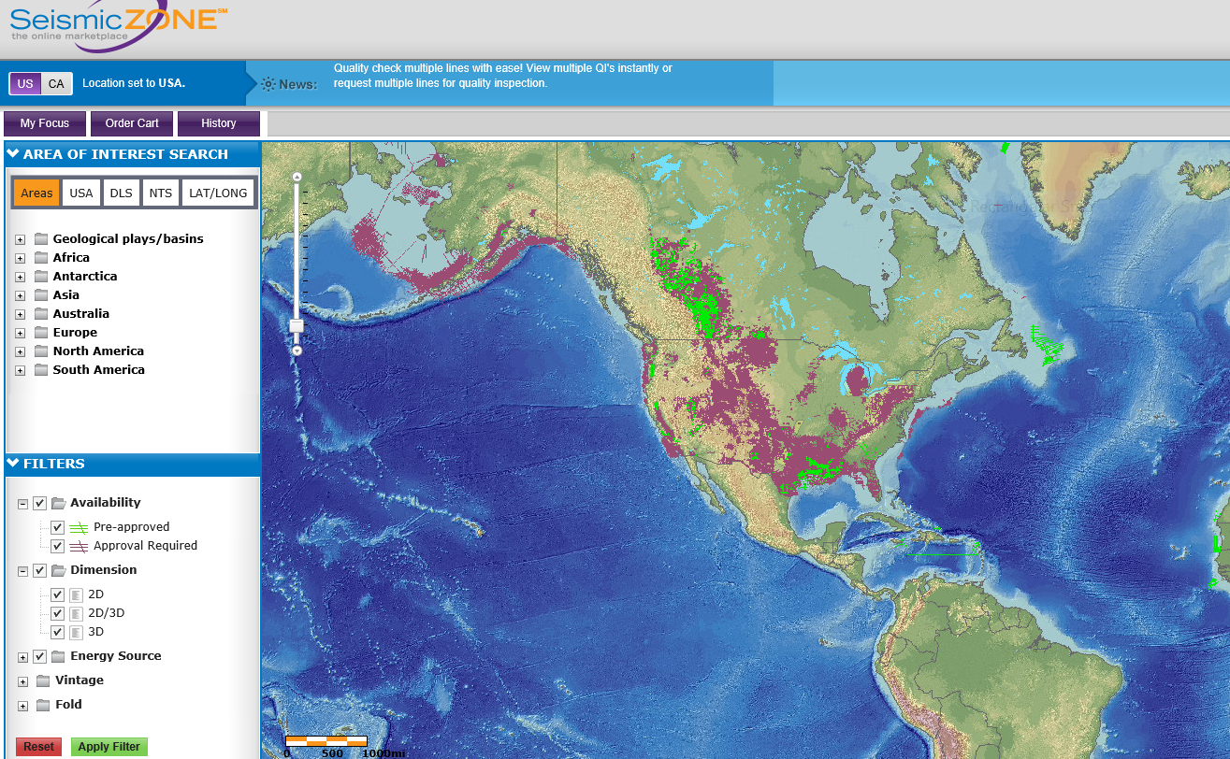
Map Issues (Canada US?)
Really does not do anything, change the map scale? What about the rest of the word, Detection, serving of tiles?
Position of the map on load is not associated to login destination. Should be able to detect where the user is logging in from, Canada, USA, Australia, etc.
Take off the focus area where there are no data.

Slide 11
Login
When you log in the map should be centered to your zone of industry, this is a map configuration in the account setup.
The map should be smart enough to center based on your login.

Slide 12
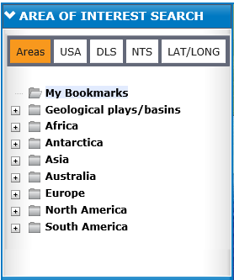
Confusing Need Some Tweaks
PLAYS/Basins, I would take those out of there and put it on the map legend, allow to be toggled on and off.
Map The panel on the left side of the map should have a default state as setup by the user.
Also Default View, for Canada, USA, Etc.
I would explore the use of a 3 level Tree
My Bookmarks
Plays/Basins
Canada
Cardium
Monty
USA
Regions
North America
My Bookmarks
Plays/Basins
Geographical Regions

Slide 13
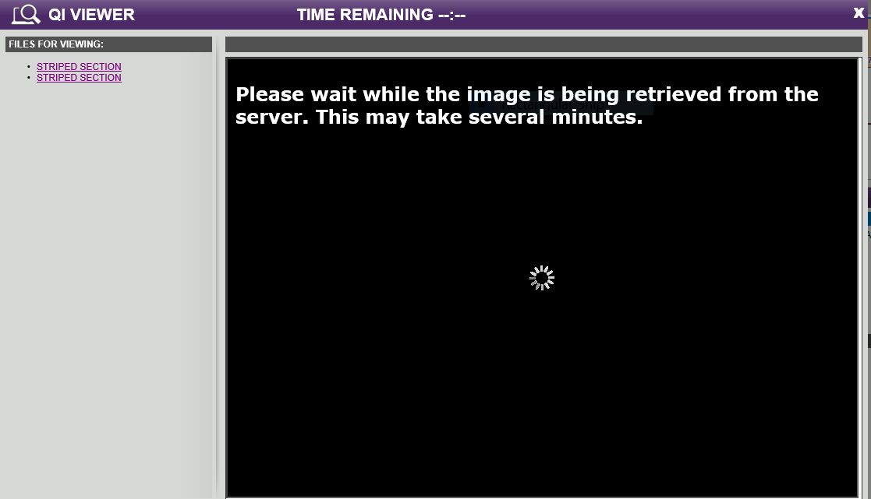
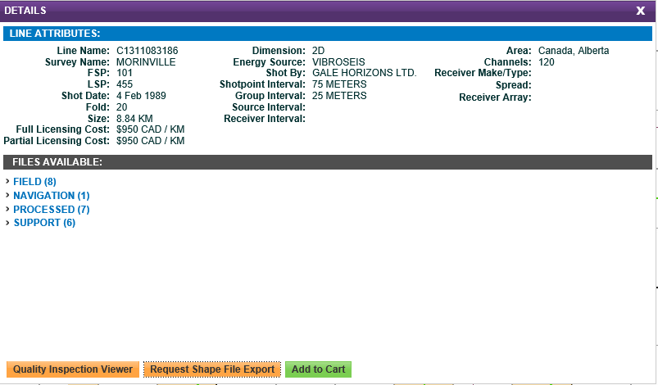
Not Acceptable for QI material
Shape file export looks manual in nature, it needs to be automated.
This needs to be on disk.

Slide 14
Process Client (Katalyst Manages Sales Desk)
Sales Desk
Client
Broker
Katalyst
Client
Data
Owner
Oil
Company
Charge Brokerage Fee
Charge Data Management Fee
Charge Reproduction Fee
Collect all the data
Get all the approvals
Save sale Information

Slide 15
Process Broker (Katalyst Manages Sales Desk)
Sales Desk
Broker
Marketing
Agreement
Katalyst
Client
Provide Partnership Approval
Track QI Material
Provide Inventory List
Track client sale information
Data Management Fee
Reproduction Fee

Slide 16
QI Process
See QI process outline.

Slide 17
Data Owners (Suggestions)
Don’t ask them if you can put their lines on your map
Of course it ok simply tell them your going to broker data
Ensure the recognize you as a legitimate data broker for their data
How do we conduct a business transaction when we get one
What are the terms of the sale
In some cases you need to confirm a MLA is signed
Confirm the brokerage fee of 10%
You manage the entire sales process, deliver the data, earn the money
Data Owners you should work with
Pulse, GSI, Seitel, Arcis, SEI, TGS, etc
Brokers will not show Seitel lines so you have an advantage over the brokers, you will take Seitel's 5% its ok for you. It will give your site some advantages.

Slide 18
Data Management Fee
Partnership approvals should be part of the service you apply for your clients.
You will track their sales
You update their system with sale data
Provide their partnership approvals
Collect money on their behalf
Store a copy of entitlements
Execute their MLA’s
Deliver the data

Slide 19
Katalyst Advantage (Seitel Advantage with Industry)
Thinking ?
Seitel
Brokers will not sell Seitel data because they only pay 5% commission
Data owners don’t put Seitel's Lines on their map
You have an opportunity to get more money because you also do the reproduction, add 5%.
You have a special relationship with
Prairie Sky, Heritage Oil to your advantage
Change the paradigm, buy a data company to kick start it.

Slide 20
QI Packages Must work at Lowest Level
PDF
Plat
Parameters
Line List
Sections
Pricing
Broker Reference Number
Partner Approvals
Printable
Set up so they are one button print to standard printer
Electronic Download
Tracked pull from website
Professional
High quality,

